Slide 1
SQLGraph An Efficient Relational-Based Property Graph Store
IBM & Google @ SIGMOD ’15
present by Minyu Chen
Notes:
重点 ： 属性图 / 基于关系的

Slide 2
Outline
Background & Motivation
Method & Design
Evaluation
Conclusion

Slide 3
Background & Motivation
Graph Data Models : RDF Graph or Property Graph

Slide 4
Background & Motivation
Graph Data Models :
RDF Graph : Everything in triples
SJTU
College
Zemin Jiang
Description
Chairman

Slide 5
Background & Motivation
Graph Data Models :
RDF Graph : Everything in triples
Property Graph : Graph of rich objects
Uri = ‘Zemin Jiang’
Description = ‘Chairman’
Uri = ‘SJTU’
SJTU
College
Zemin Jiang
1
2
65535
Description
Chairman
Uri = ‘College’
Section = ‘External_link’
….
Notes:
Chairman不是作为一个实体，所以作为Jiang的属性。

Slide 6
Background & Motivation
Graph Data Models :
RDF Graph : Everything in triples
Property Graph : Graph of rich objects
Graph Querying Languages:
RDF Graph : SPARQL
Property Graph : Gremlin , Cypher , …
Notes:
SPARQL是定义式语言，而Gremlin是过程型语言，是对图的某种遍历的表示。

Slide 7
Background & Motivation
Graph Data Models :
RDF Graph : Everything in triples
Property Graph : Graph of rich objects
Property Graph Stores:
Neo4j
Titan
Built with noSQL store or native support graphs
Notes:
Neo4j原生支持图的表示，Titan用到了BerkeleyDB (key-value), Titan已经停止服务

Slide 8
Background & Motivation
What does this paper wanna do? :
Build a Relational-Based store !
Notes:
形象点说，把图塞进关系数据库里面

Slide 9
Method & Design
Build a Relational-Based store
What this store need?
A schema
A querying language
A different benchmark to evaluate
Notes:
Schema : 数据库的组织和结构

Slide 10

Method & Design
Property Graph
Schema
Adjacency
Vertex/Edge Attributes
Information Divide
Tables or Json ?
Information Storage
SQL DBs
Tables filled with Json
Implementation
Notes:
最底层调用的别人的Database

Slide 11
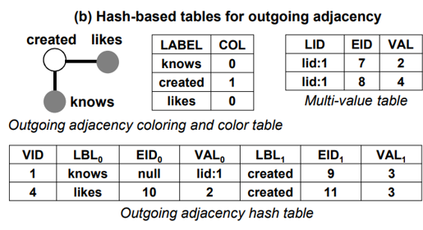
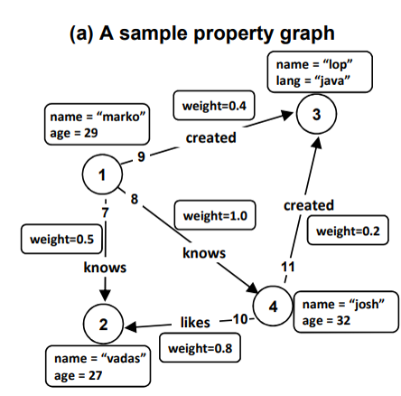
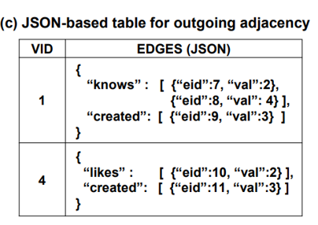
Method & Design
Schema : Tables or Json?
Adjacency
Notes:
Hash:coloring做的，真实图染色 hash likes和knows碰撞 所以被放在了一列(column,竖的) 节点是1 EID = EDGE ID VAL = OUTNODES 碰撞应该是按照拉链法来的

Slide 12
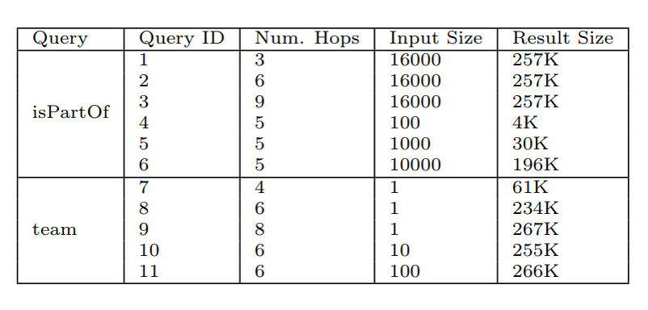
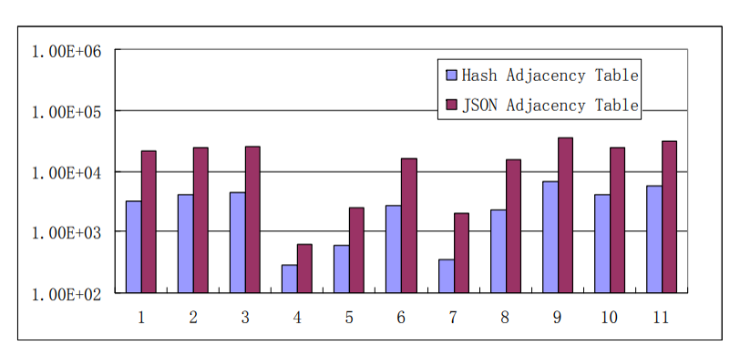
Method & Design
Schema : Tables or Json?
Adjacency
Micro Benchmark
Dataset : DBPedia (Modified)
X : QueryID
Y : Time / ms (Log)
Mean :
Hash : 3.2s Json : 18.0s
Hash Table is always Better!
Notes:
变量：Hops / input size / Query type 时间取了对数

Slide 13
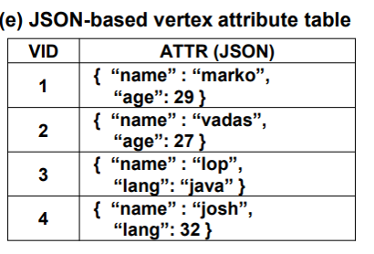
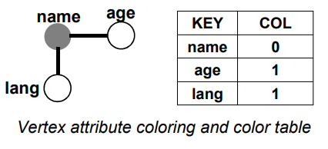
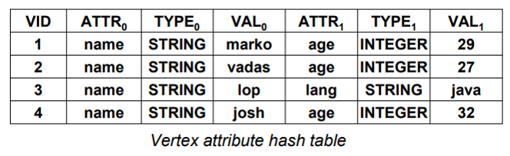
Method & Design
Schema : Tables or Json?
Attributes
Difference : No multi-value table because property is unique
Notes:
Name Age Lang是属性值 age / lang 又碰上了 因为一个东西不会具有lang/age两种属性（图染色，所以会在一个桶子里

Slide 14
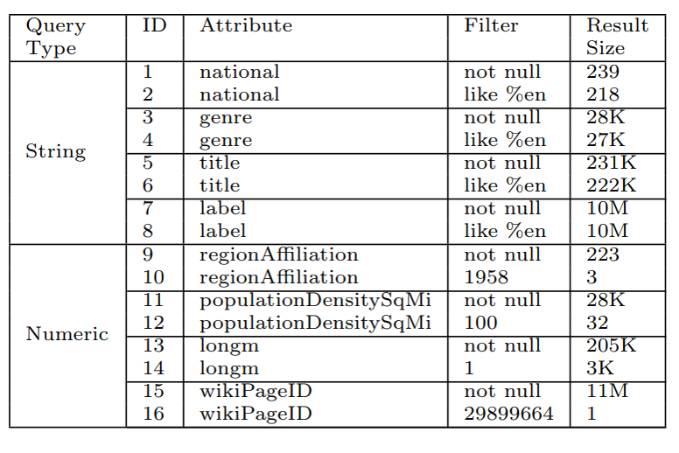
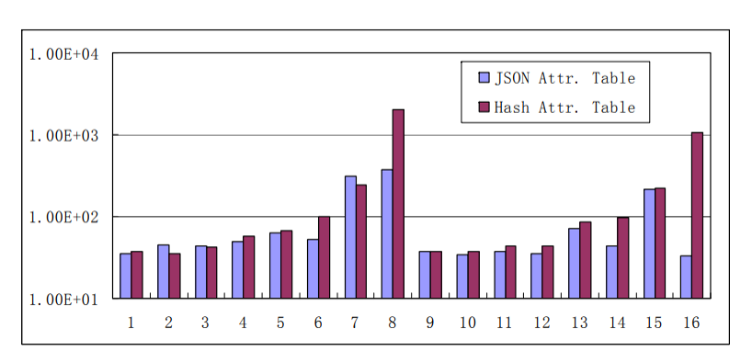
Method & Design
Schema : Tables or Json?
Attributes
Micro Benchmark
Dataset : DBPedia (Modified)
X : QueryID
Y : Time / ms (Log)
Mean :
Hash : 265s Json : 92s
Json is Better!
(It’s just a key-value lookup)
Notes:
因为时间取了对数，所以看起来优势不大，其实优势挺大的
Key-value用mongodb的话明显更快…

Slide 15
Method & Design
Property Graph
Schema
Adjacency
Vertex/Edge Attributes
Information Divide
Hash Tables
Json
Information Storage
SQL DBs
Tables filled with Json
Implementation

Slide 16
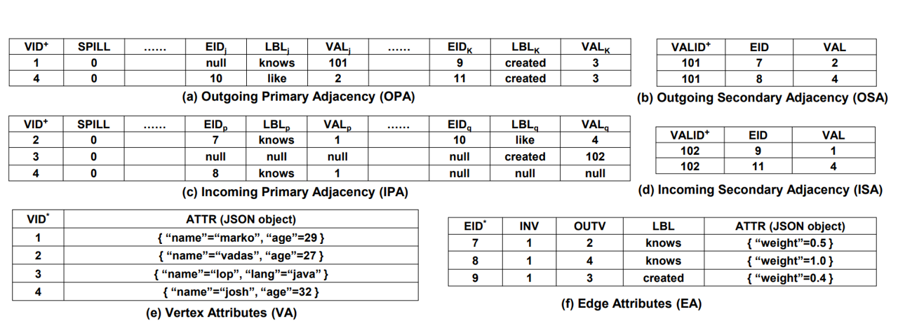
Method & Design
Schema
Facts found in Benchmark

Slide 17
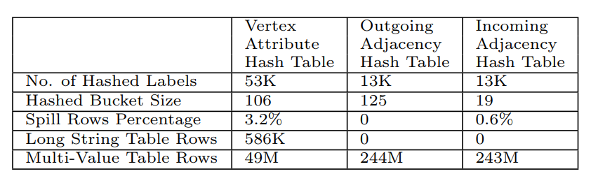
Method & Design
Schema
Facts found in Benchmark
Hash reduces sparsity
Json eliminates joins

Slide 18
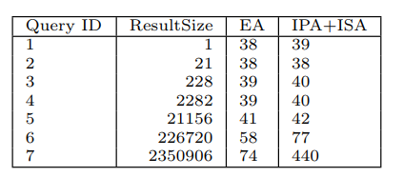
Method & Design
Schema
Facts found in Benchmark
Edge Attributes table keeps copy of edge’s adjacency
Query : Find all neighbors of a node
EA reduces the join between OPA/OSA or IPA/ISA
Notes:
OPA = Outgoing primary adjacency S = secondary 多条同属性边的表

Slide 19
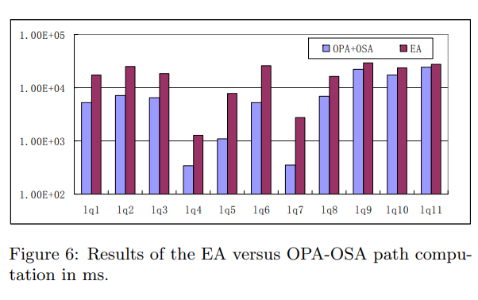
Method & Design
Schema
Facts found in Benchmark
Adjacency is also important
Query : Long path querying
Data in OPA-OSA is more compact
Notes:
OPA = Outgoing primary adjacency S = secondary 多条同属性边的表

Slide 20
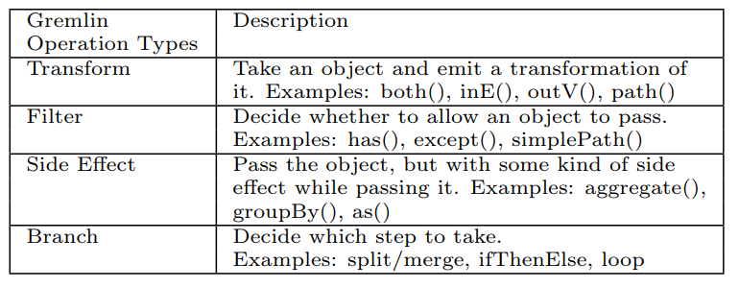
Method & Design
Query Language
Translate Gremlin into SQL

Slide 21
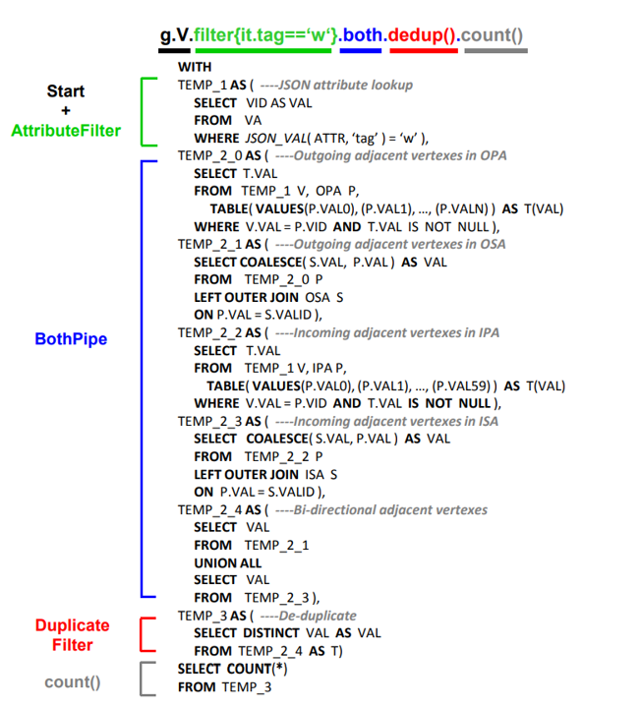
Method & Design
Query Language
Translate Gremlin into SQL
An example

Slide 22
Evaluation
Benchmarks VS Neo4j & Titan
No benchmark for Gremlin
Convert from DBPedia & LinkBench
DBPedia : Knowledge Graph (Query Time)
LinkBench : Social Graph (Throughput)
Notes:
Knowledge graph关系和属性的种类比较多 而Socaial Graph节点数量比较多

Slide 23
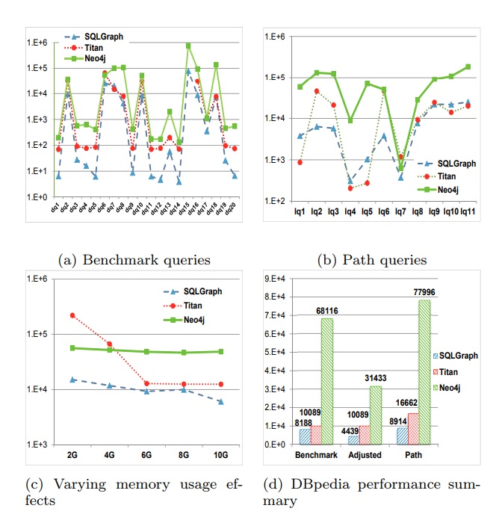
Evaluation
Benchmarks
DBPedia
Y Axis : Time / ms
2X faster than Titan
8X faster than Neo4j
(C) Total time using
limited memory
Disk :
SQLGraph : 66GB
Neo4j : 98GB
Titan : 301GB
Notes:
Titan在lq15 timeout了

Slide 24
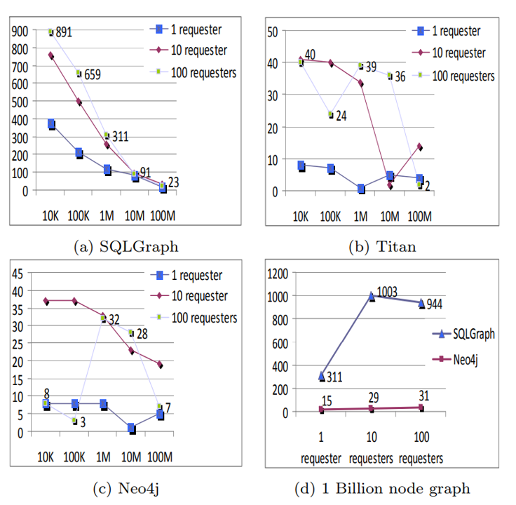
Evaluation
Benchmarks
LinkBench
X Axis : scale of dataset
Y Axis : ops / sec
Better concurrency
Disk :
SQLGraph : 850GB
Neo4j : 1.1TB
Titan : 1.7TB
Notes:
Concurrency 由 同时能处理多少个requester的任务来决定

Slide 25
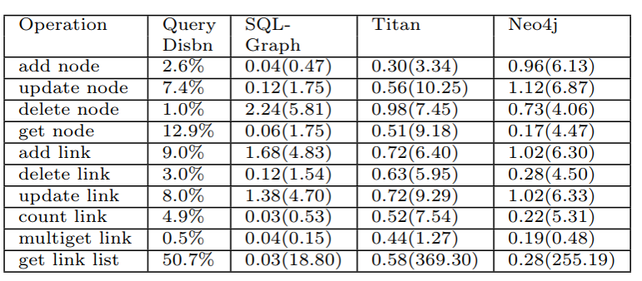
Evaluation
Benchmarks
LinkBench
CURD mean operation time
(at 100M nodes, 10 requesters)
Notes:
Knowledge graph关系和属性的种类比较多 而Socaial Graph节点数量比较多

Slide 26
Conclusion
Basic optimization really works
Different scene needs different solution
Better language compiler may make more improvements
Notes:
Knowledge graph关系和属性的种类比较多 而Socaial Graph节点数量比较多

Slide 27

Thanks !
Notes:
Knowledge graph关系和属性的种类比较多 而Socaial Graph节点数量比较多

